Slide 1
Cherokee Hiking Club The Hiking Club of the Southeast Tennessee Mountains
www.CherokeeHikingClub.org

Slide 2
Cherokee Hiking Club Monthly Meetings 2nd Thursday of each Month 6:30 dinner / 7:00 meeting
www.CherokeeHikingClub.org

Slide 3
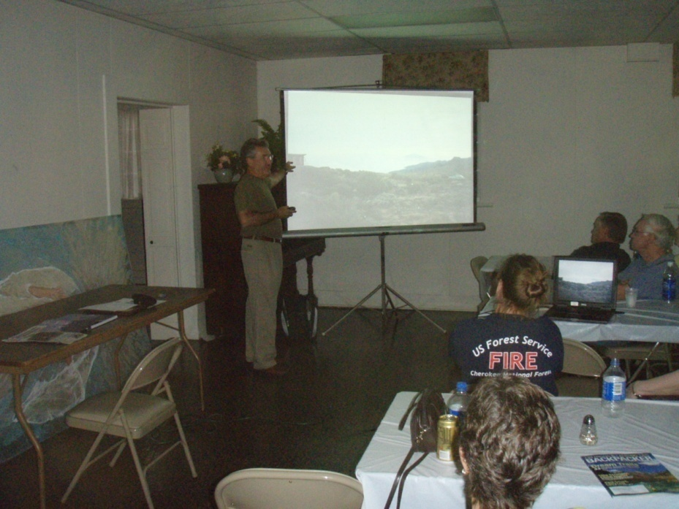
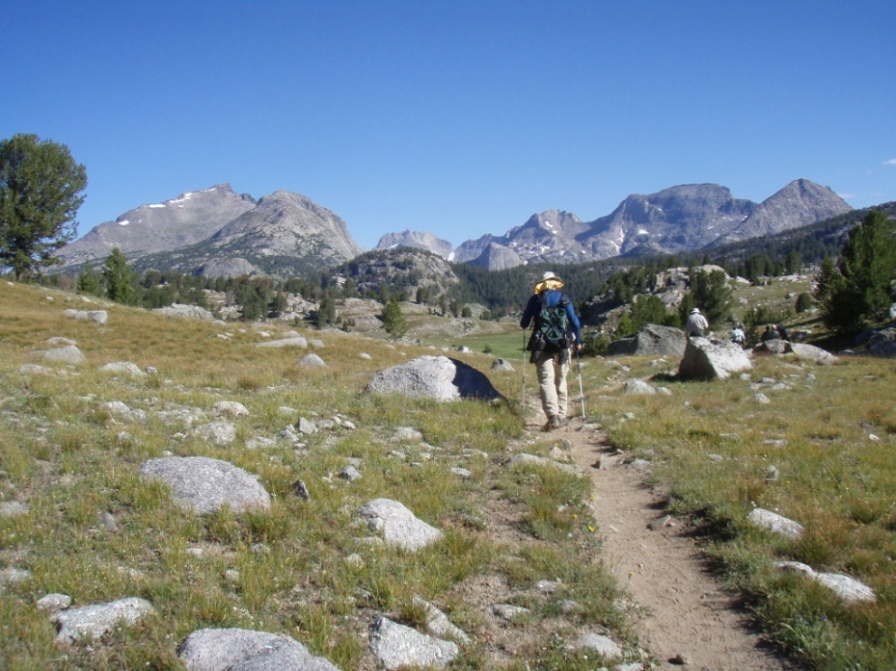
Our Meetings
James telling us about
His backpack trip up
Mount Kilimanjaro
Rick showing pictures
From his 2-week
backpack on the CDT in
the Wind River Range

Slide 4
Cherokee Hiking Club Hikes mostly on weekends ranging in difficulty from easy to difficult, 3 – 16 miles
www.CherokeeHikingClub.org

Slide 5
Big Frog Wilderness

Slide 6
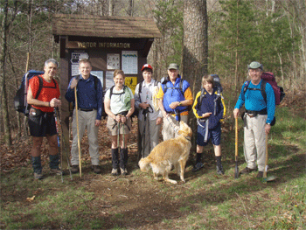
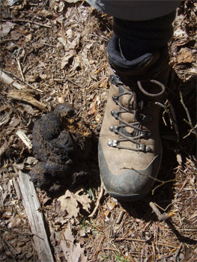
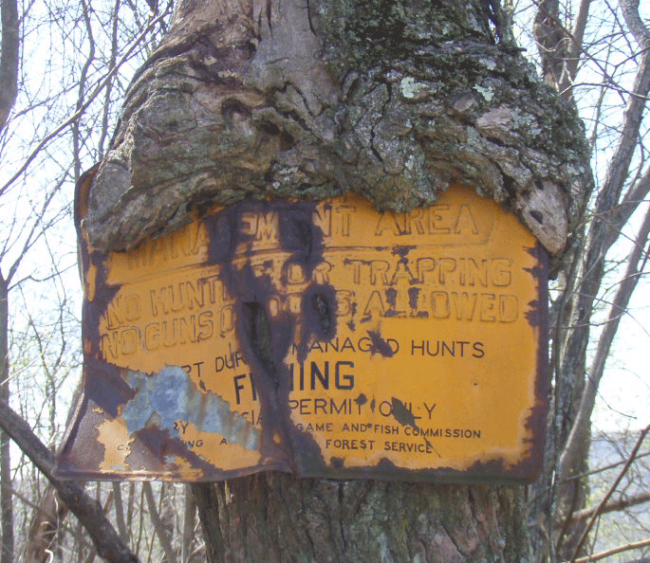
Big Frog Wilderness
Kiosk at
Trailhead
The Green Tunnel
Bear Scat
Overgrown sign

Slide 7
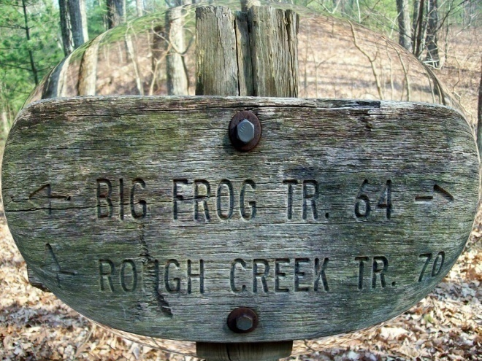
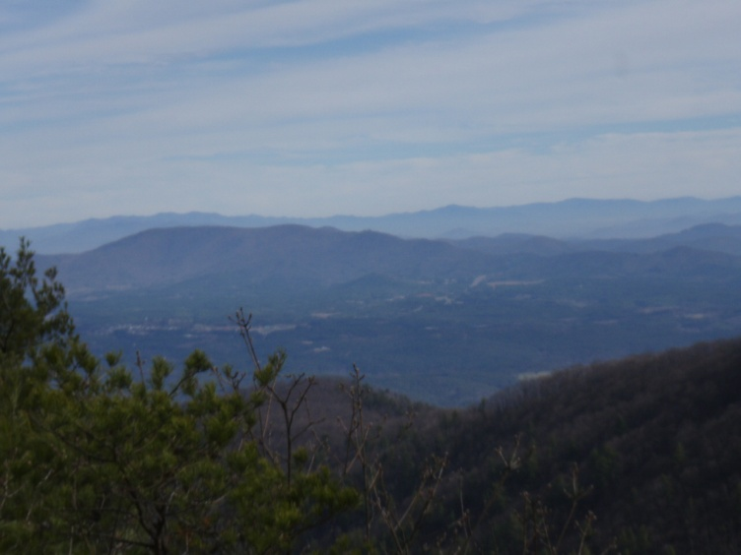
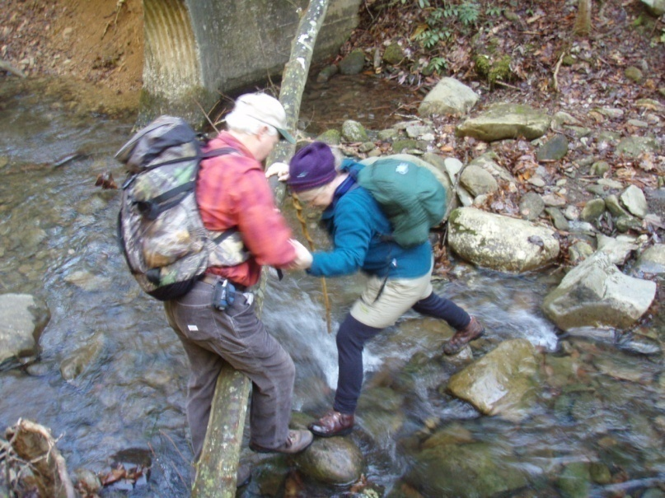
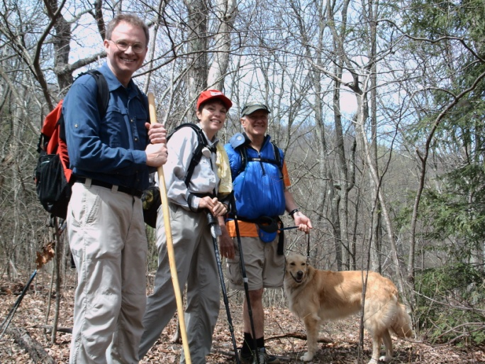
Big Frog Wilderness
Crossing Rough Creek

Slide 8
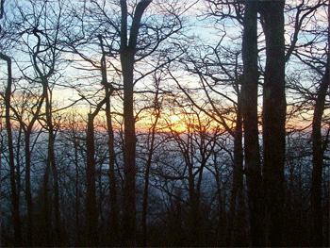
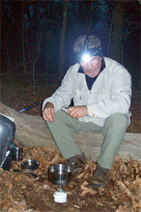
Big Frog Wilderness
Sunset at 4600 feet
Adelgid on hemlocks
Moonlight Hike
Snacks at the top

Slide 9
Cherokee Hiking Club Join our Club Get fit and have a great time ! Much more fun than the health club gym Applications are on our website
www.CherokeeHikingClub.org

Slide 10
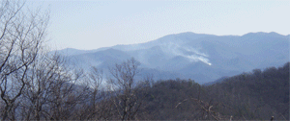
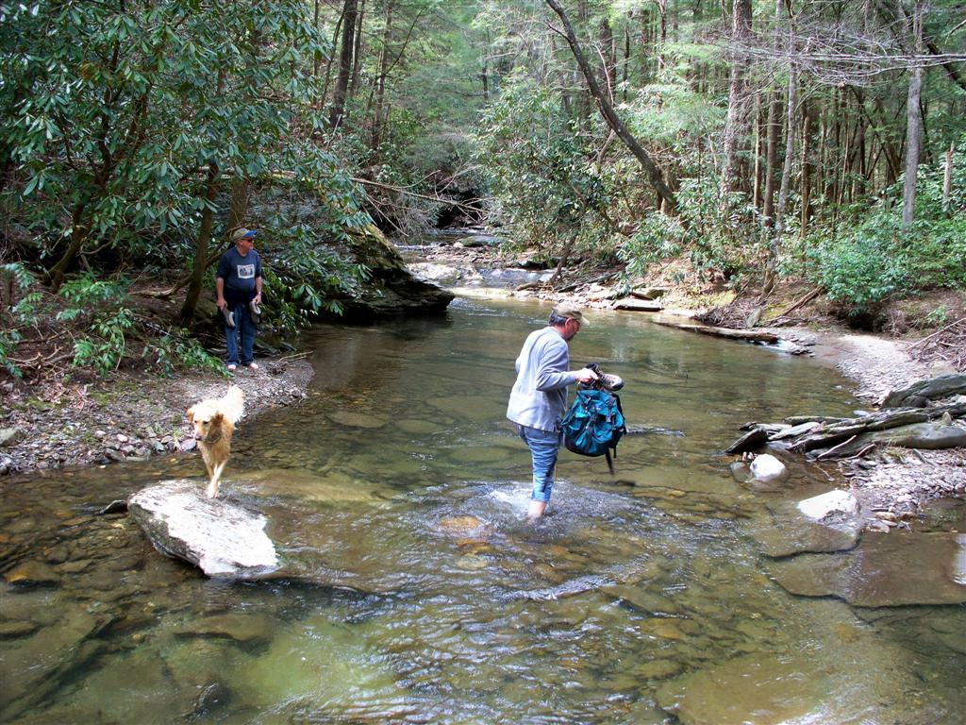
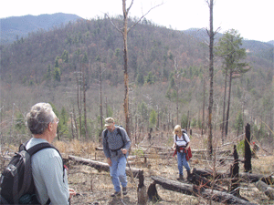
Warrior’s Passage National Scenic Trail
The view from the top
Prescribed burn
Waucheesi Bald
Crossing Wildcat
Creek
The burned over section

Slide 11
Warrior’s Passage National Scenic Trail
Trail access map
Warriors Passage Trail Blurb
on our website at www.CherokeeHikingClub.org

Slide 12
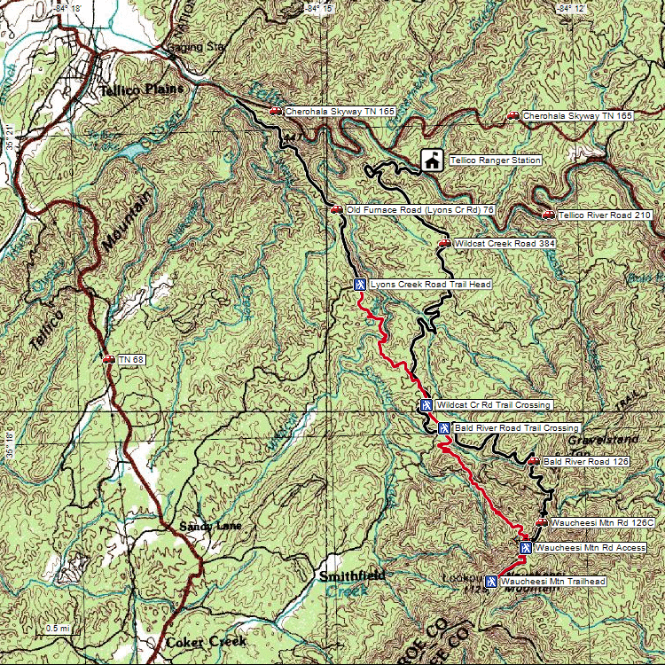
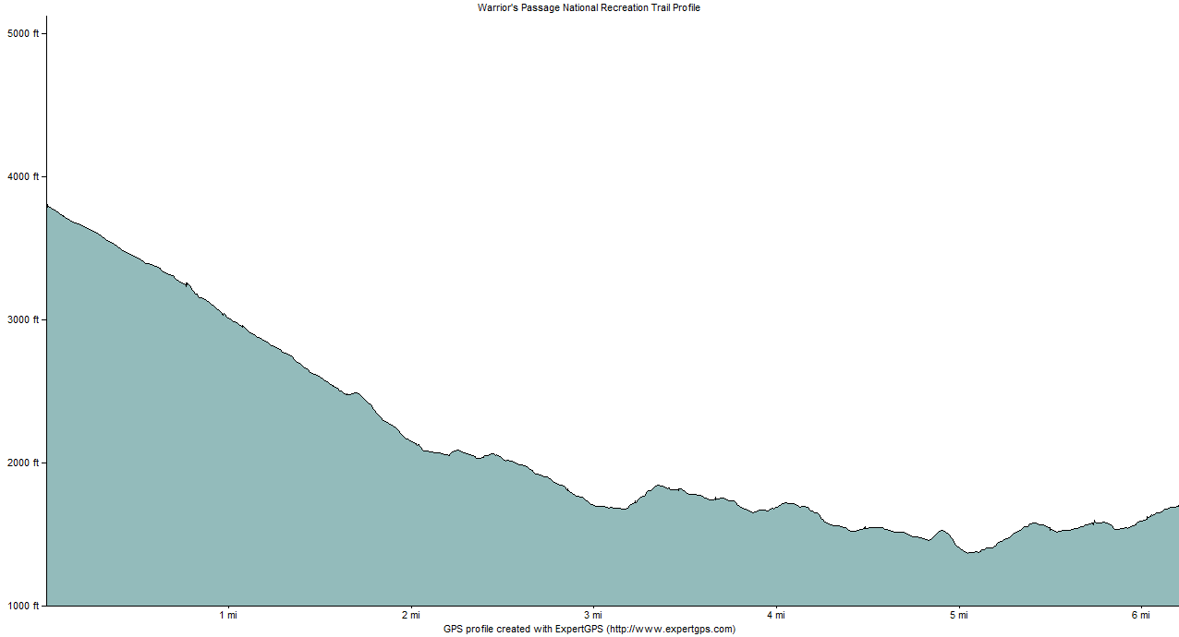
Warrior’s Passage National Scenic Trail
Elevation Profile
Trail access map
Trail map from trail blurb on our website
At www.CherokeeHikingClub.org

Slide 13
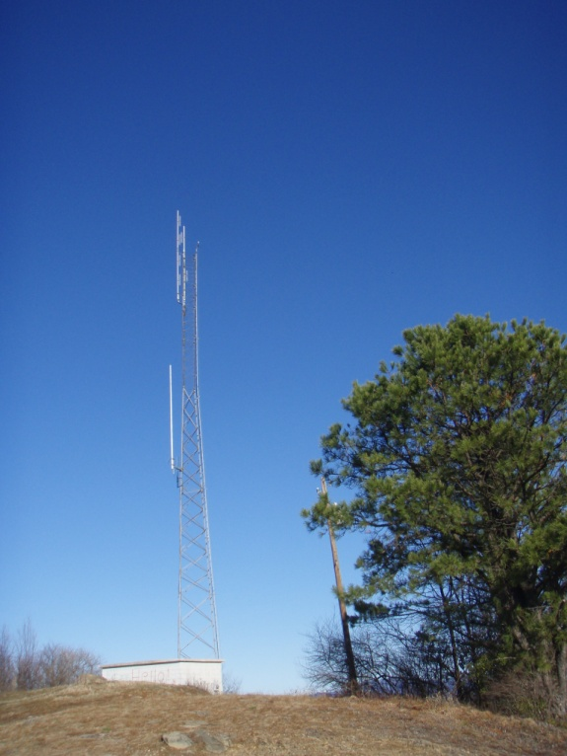
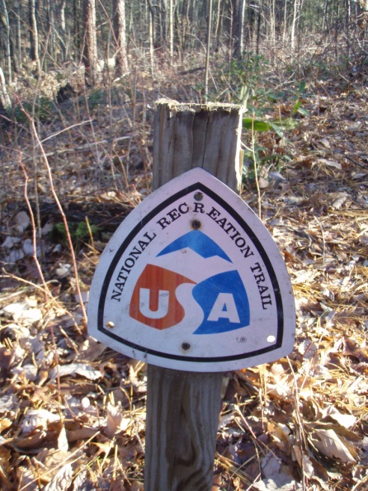
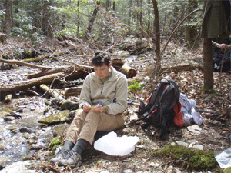
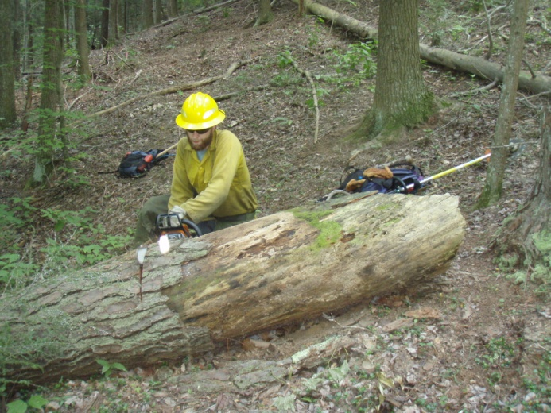
Warrior’s Passage National Scenic Trail
Where the
fire tower
Used to be
Maintaining
the trail is not an easy job
Lunchtime

Slide 14
Cherokee Hiking Club Regular trailwork schedule in the Cherokee National Forest usually on weekdays
www.CherokeeHikingClub.org

Slide 15
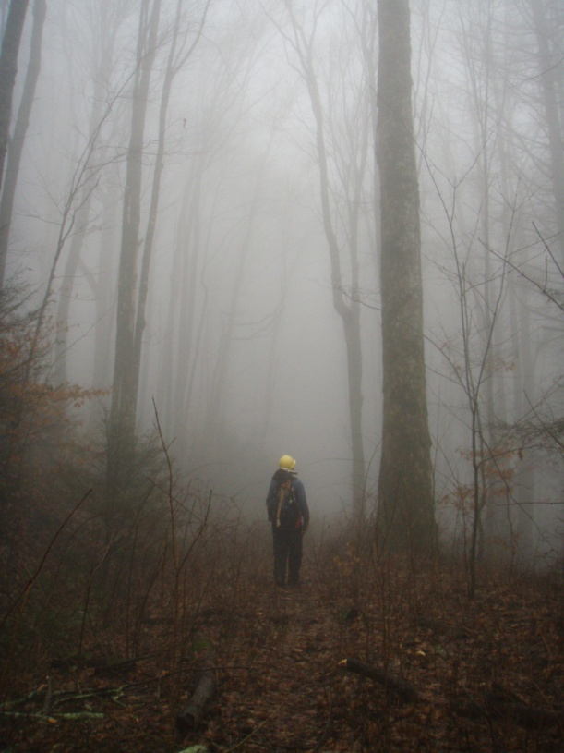
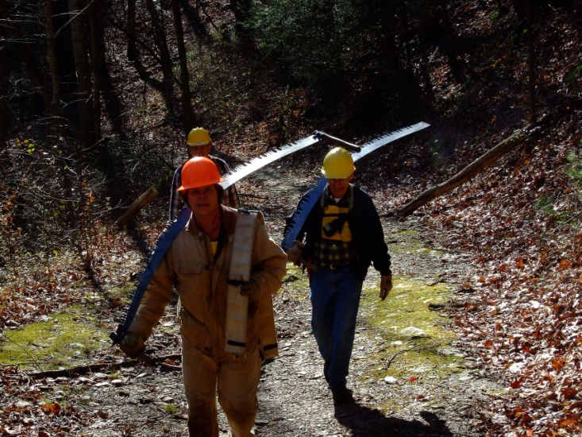
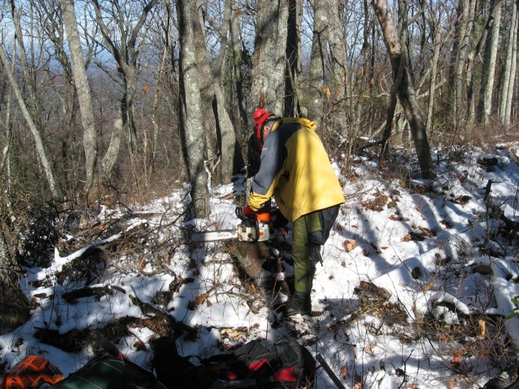
Trail Maintenance in the Cherokee National Forest
Sometimes
the adversity
of the trail is
beautiful and
makes it all
worthwhile
Sometimes it
rains or we are
working in a
fog bank or the snow

Slide 16
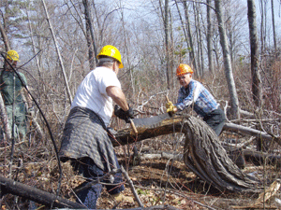
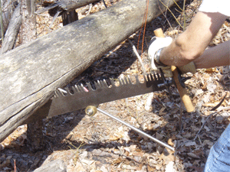
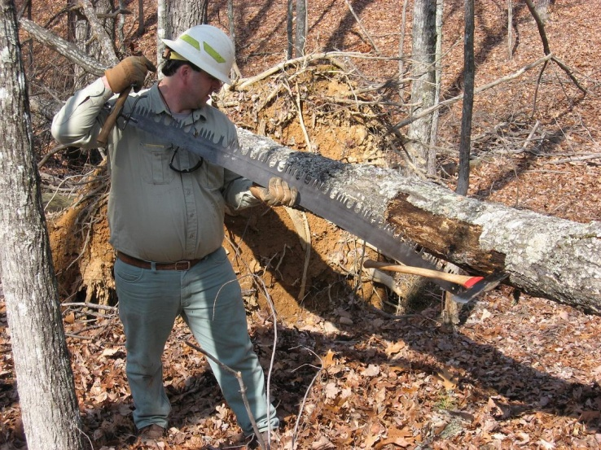
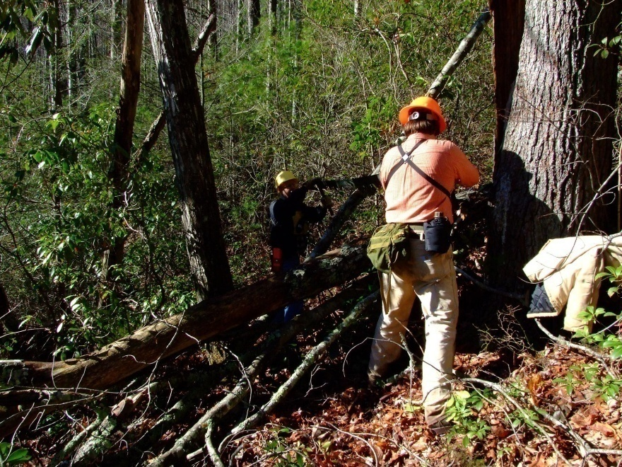
Trail Maintenance in the Cherokee National Forest
Much of the
CNF Is in
wilderness
and must be maintained
with crosscut saw, axe and loppers

Slide 17
Cherokee Hiking Club Hikes mostly on weekends ranging in difficulty from easy to difficult, 3 – 16 miles
www.CherokeeHikingClub.org

Slide 18
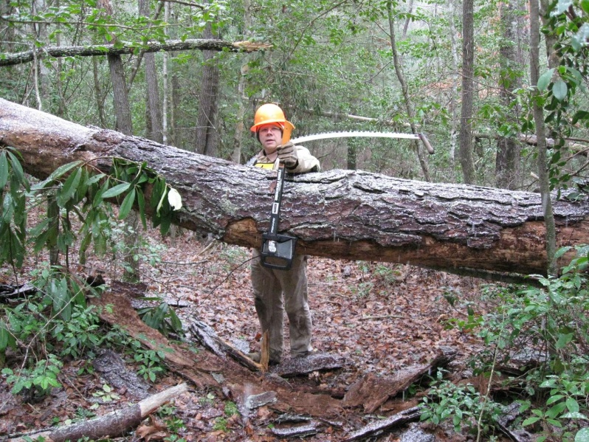
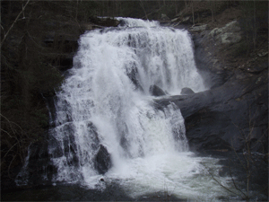
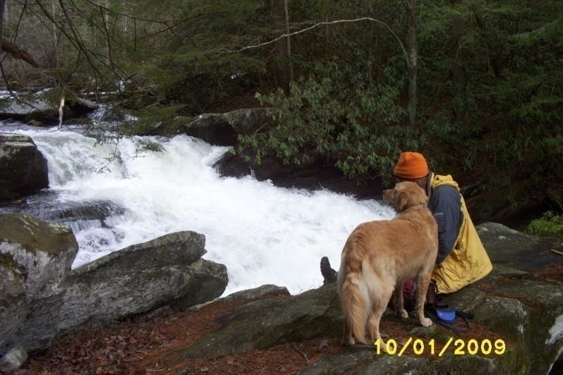
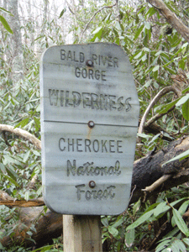
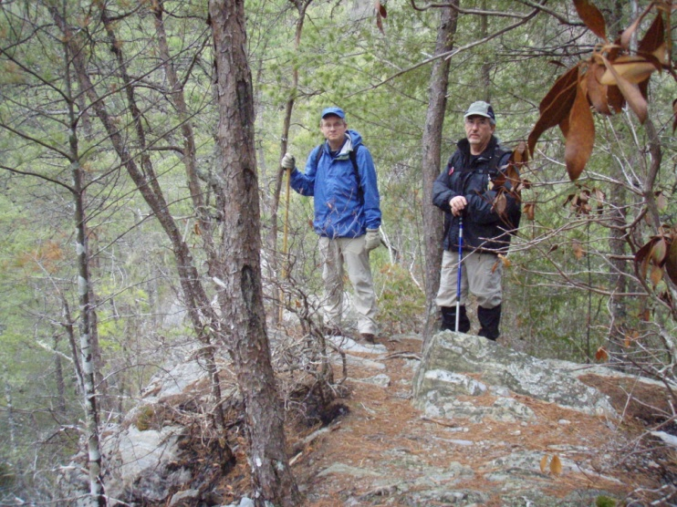
Bald River Trail
There is
always more
maintenance
to do
Bald River Falls
Dogs are welcome
on our hikes

Slide 19
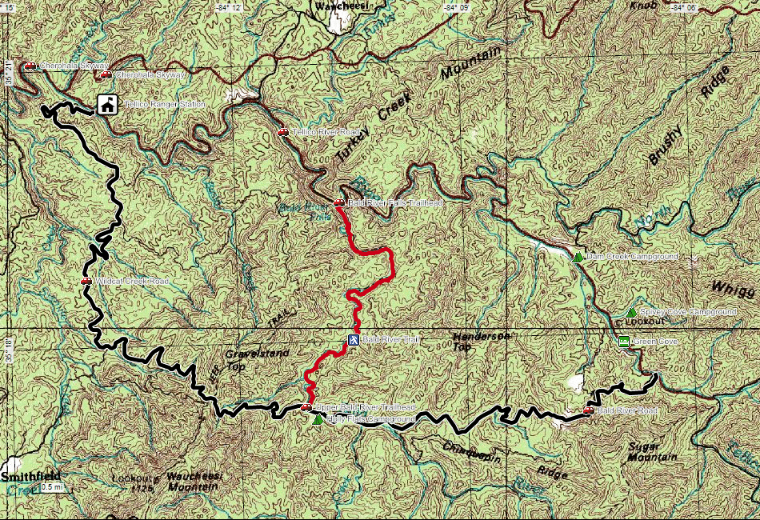
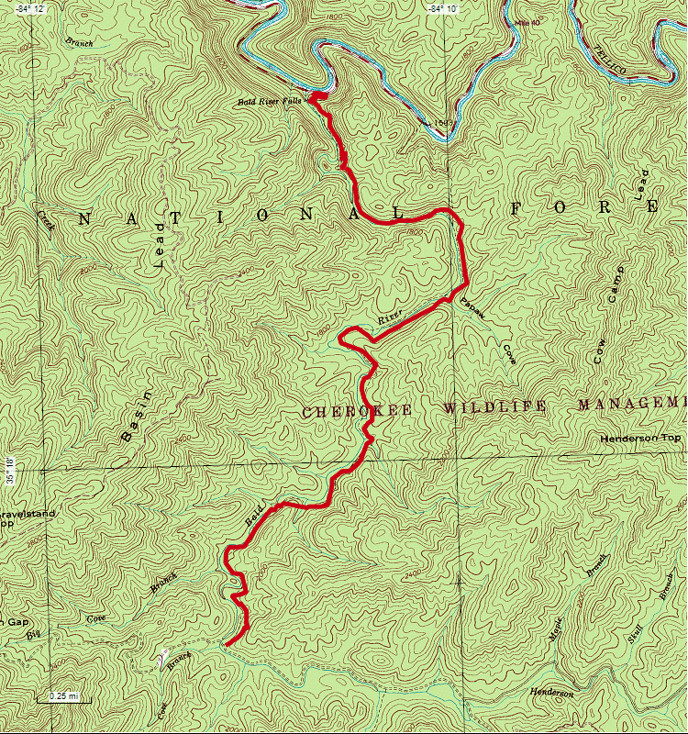
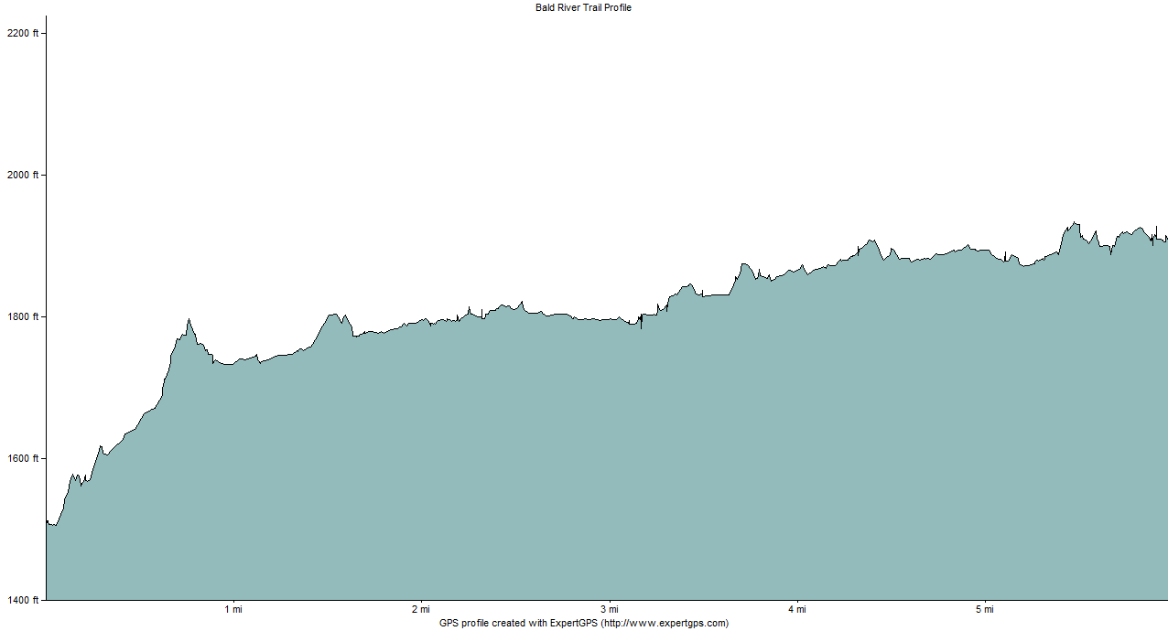
Bald River Trail
Maps and profile from
our trail blurb

Slide 20
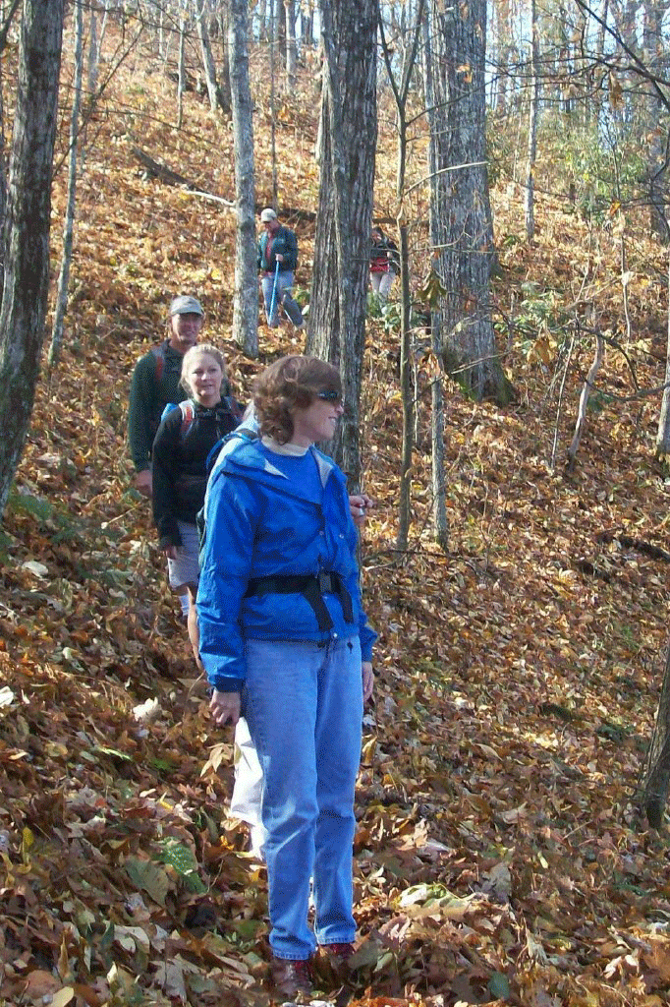
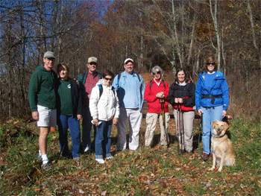
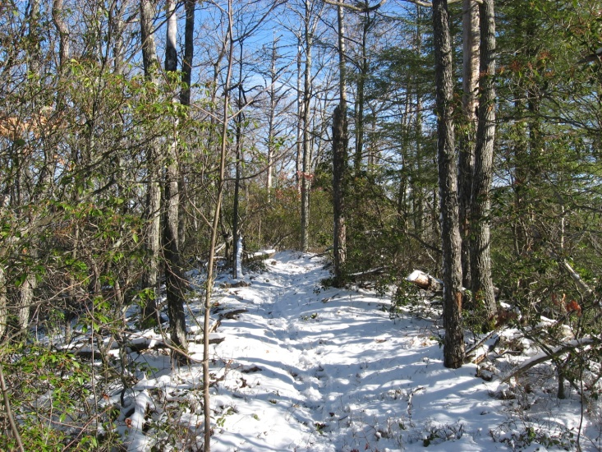
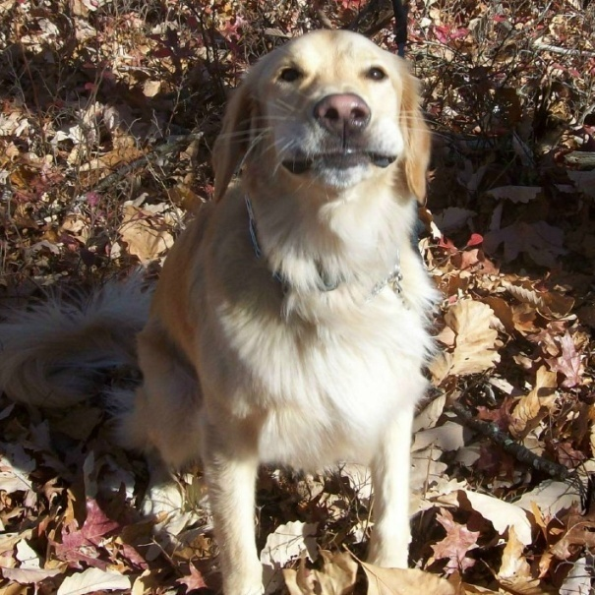
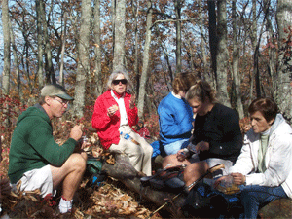
Flats Mountain Trail
Hiking in the winter
Lunch
Please pet me behind my ears

Slide 21
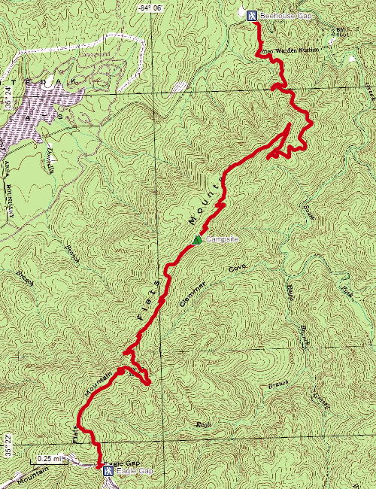
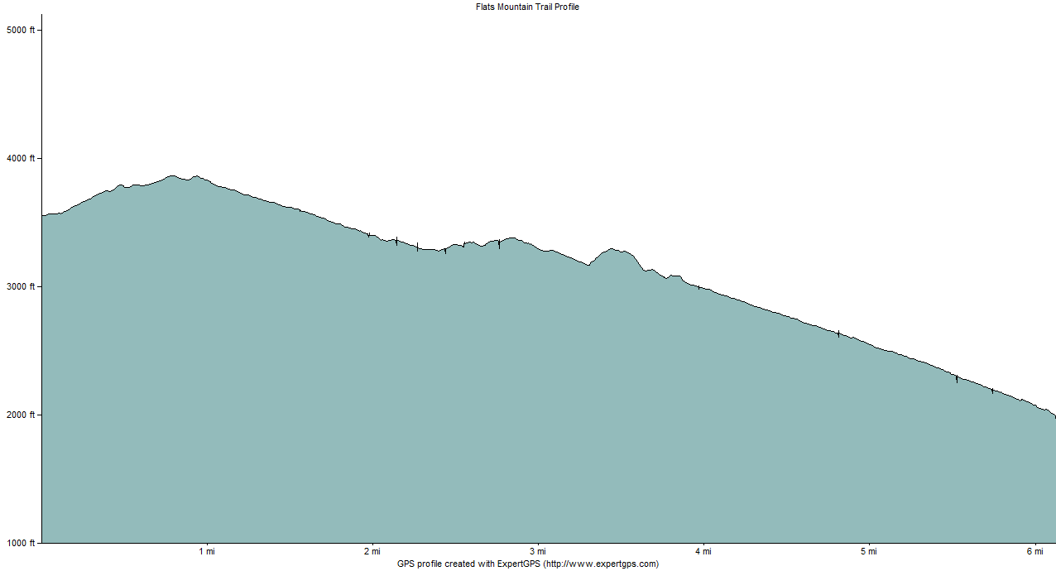
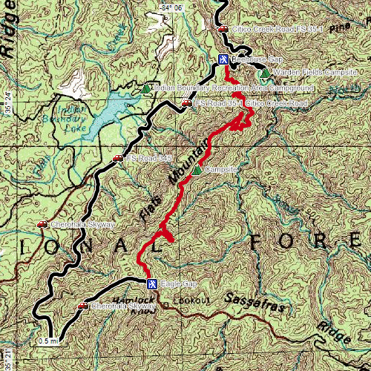
Flats Mountain Trail
Blurbs are on our website

Slide 22
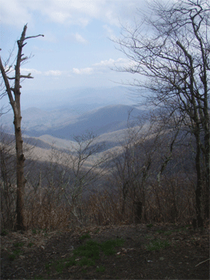
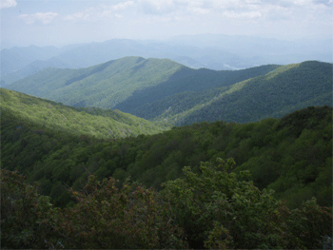
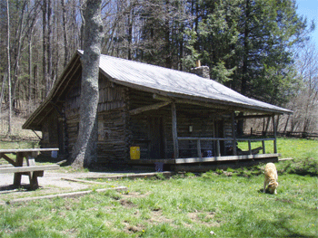
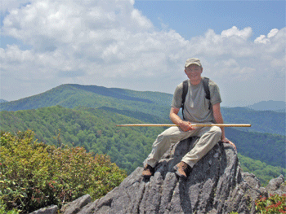
Bob Bald and the Hangover
View from Hangover
View from
Naked Ground
Swan Cabin
The Hangover at 5000 feet

Slide 23
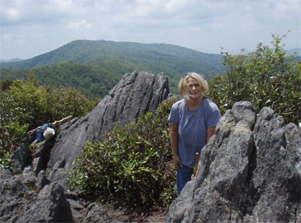
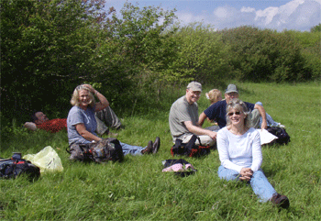
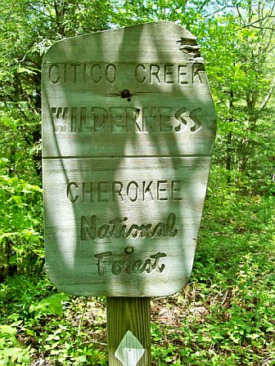
Bob Bald and the Hangover
Lunch on Bob Bald
The Hangover
Entering Citico Creek
Wilderness, leaving
Joyce Kilmer – Slickrock
Wilderness
Bob Bald
Haoe

Slide 24
Cherokee Hiking Club Backpack Trips – 3-4 per year
www.CherokeeHikingClub.org

Slide 25
Snowbird Wilderness Backpack
Big Snowbird
Creek Middle
Falls
Big Snowbird Upper Falls

Slide 26
Pot Point, Signal Point & Mullins Cove Trails
Mushroom
Rock
Mullins Cove
Fat Man’s Sqeeze
Sunset over the
Tennessee River
Snooper’s
Rock

Slide 27
Pot Point, Signal Point & Mullins Cove Trails
Suck
Creek
Bridge
The Rock House

Slide 28
Scenic Spur Trail
Upper Rock Creek Falls
Cooling off
Lower
Rock Creek
Falls
Crossing
Rock Creek

Slide 29
Cherokee Hiking Club Join our Club Get fit and have a great time ! Much more fun than the health club gym Applications are on our website
www.CherokeeHikingClub.org

Slide 30
Starr Mountain Trail
Hiwassee River
Rain or
shine
Not much of a view today,
but it sure is surreal

Slide 31
Turtletown Falls Trail
Upper Falls
Lunch at
the Lower
Falls
Lower Falls

